Slide 2
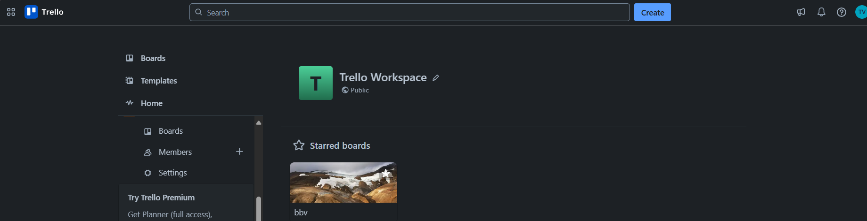



FUNCTIONS IN THE TRELLO SYSTEM
bbv Software Services AG | 21/07/2025

Slide 3
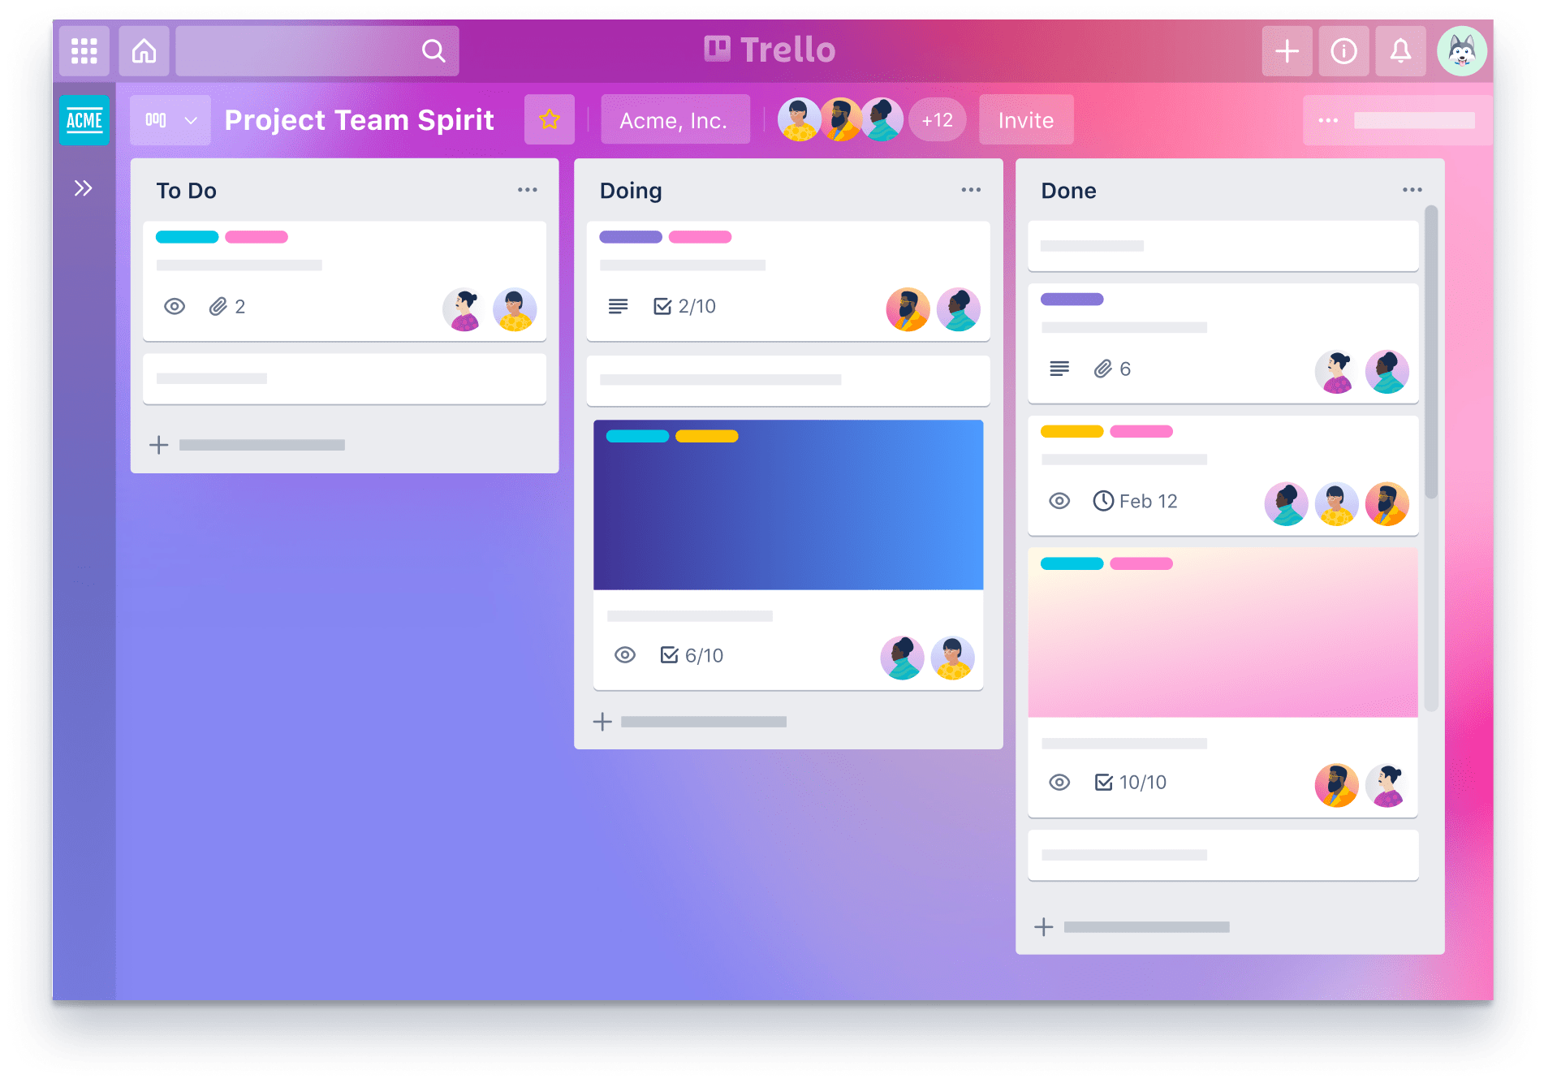
Agenda
Introduction
Functionality and UI in the Trello System
Q&A

Slide 4
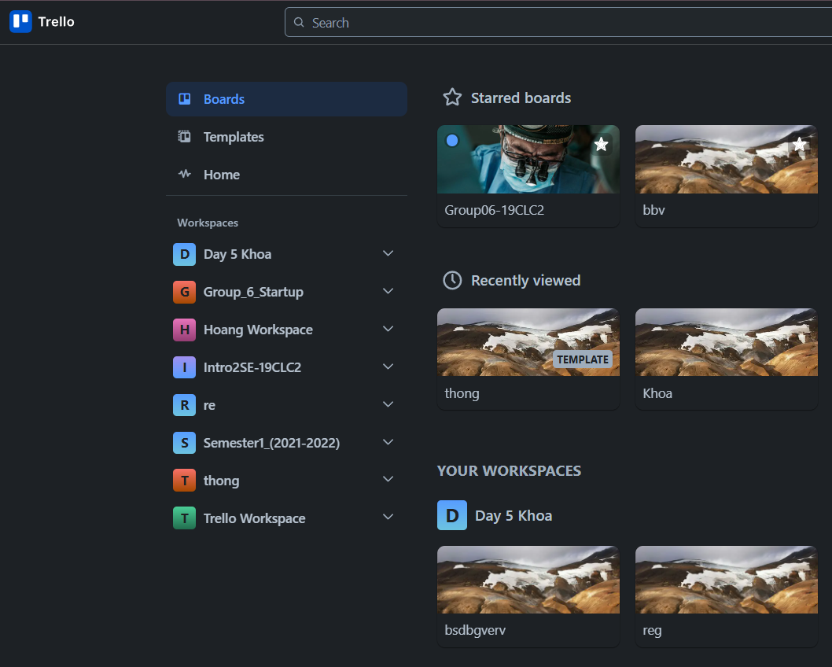
Introduction
What is Trello
Trello is a tool, organize for managing projects, tasks and track progress.
a simple table or database
Let’s users:
Create boards
Add cards to represent tasks
Add checklists to break tasks into subtasks
Set due dates to track deadlines

Slide 5
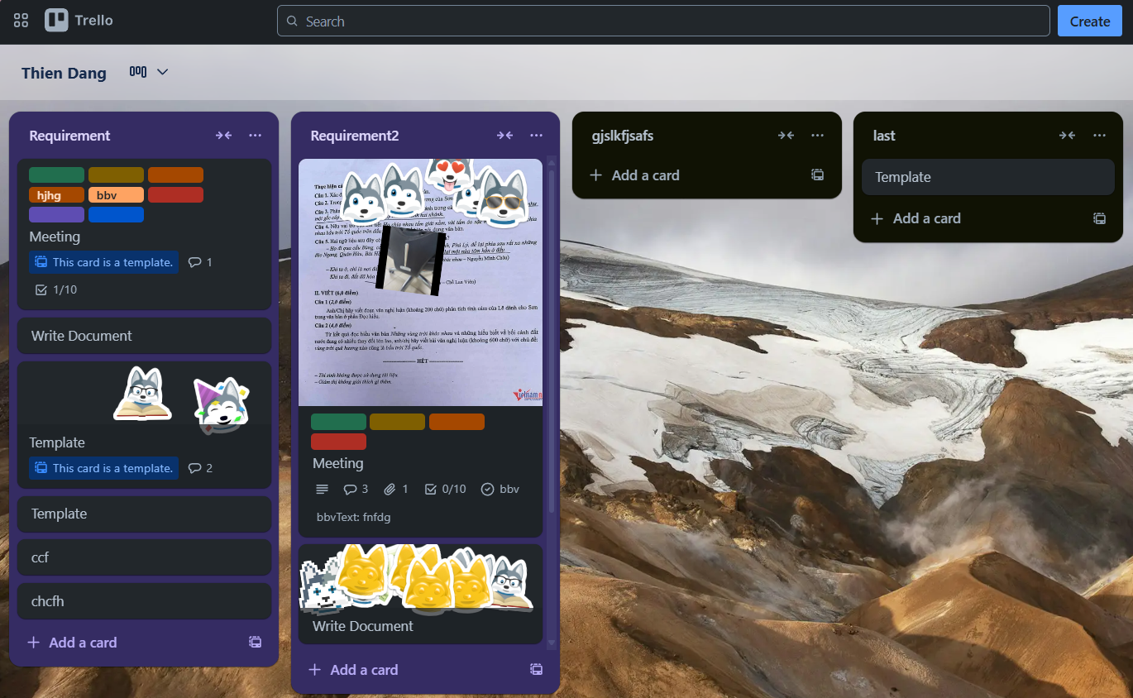
Key Functionalities
Create boards
Add cards to represent tasks
Add checklists to break tasks into subtasks
Set due dates to track deadlines

Slide 6
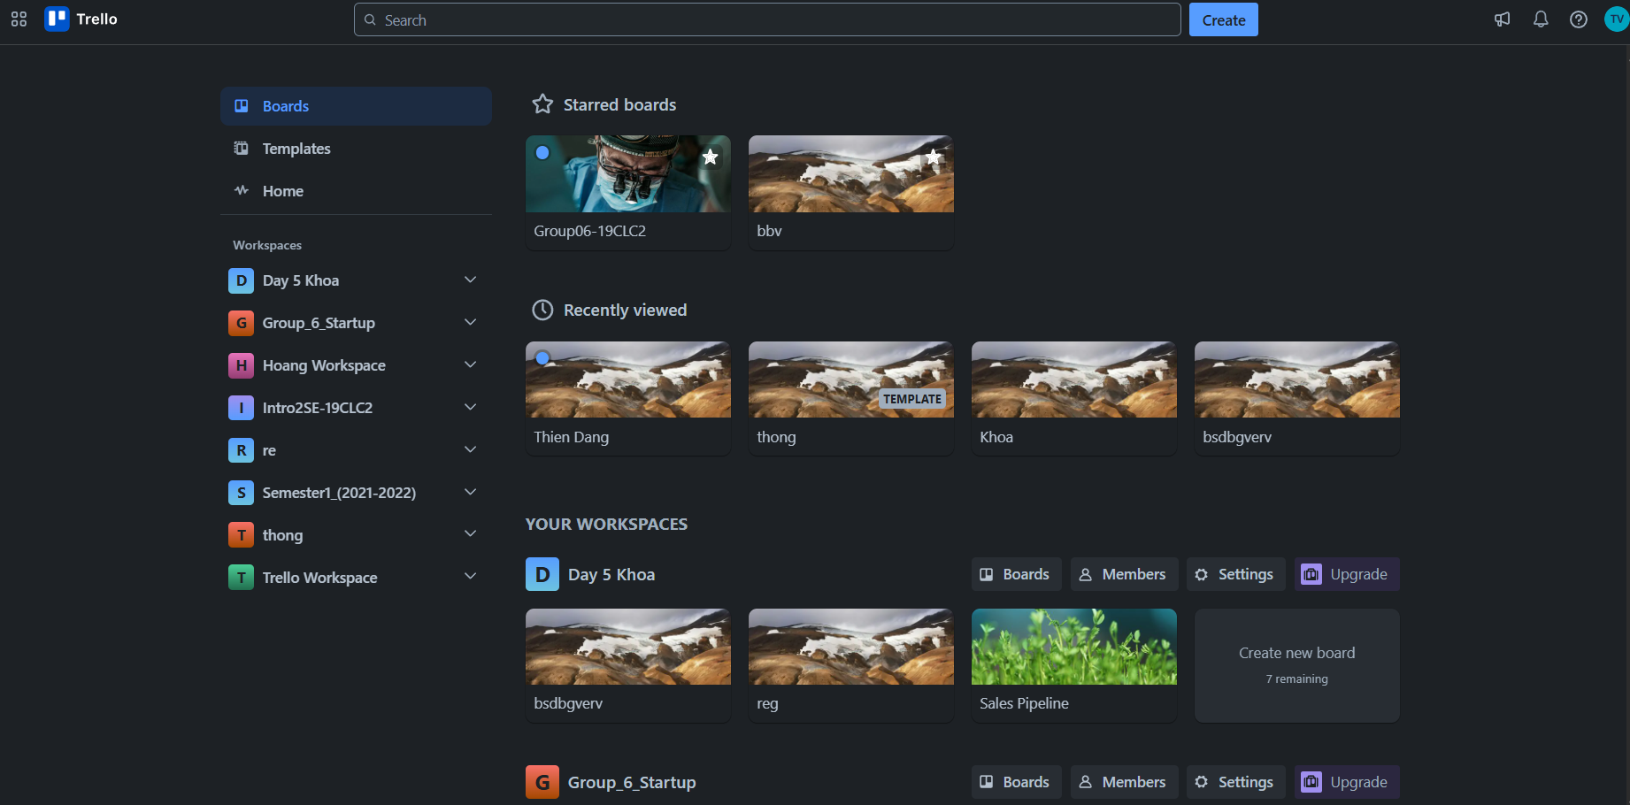
BOARDS TAB SCREEN
UserStarredBoard
User
StarredBoardStatus
Board
UserViewHistory
BackgroundUrl
Worksapce
BoardName
IsTemplate
Member
LogoUrl
WorkspaceName
Notes:
-- Get 4 recently viewed boards by user(id=1)
SELECT TOP 4 b.Id, b.BoardName, b.BackgroundUrl
FROM Boards b
JOIN BoardUsers bu ON bu.BoardId = b.Id
JOIN Users u ON u.Id = bu.UserId
WHERE bu.UserId = 1
ORDER BY bu.AccessedAt DESC;
-- Homepage: Workspace, Member
-- Get all workspace that User(id=1) is member
SELECT w.Id, w.WorkspaceName
FROM Workspaces w
JOIN Members m ON m.OwnerId = w.Id
JOIN OwnerTypes ot ON m.OwnerTypeId = ot.Id
JOIN Users u ON u.Id = m.UserId
WHERE ot.OwnerTypeValue = 'Workspace' AND u.Id = 1;
-- Get list all board that User(i=1) is member for each Workspace
SELECT b.Id AS BoardId, b.BoardName AS BoardName, w.WorkspaceName AS WorkspaceName, b.BackgroundUrl
FROM Boards b
JOIN Members m ON m.OwnerId = b.Id
JOIN OwnerTypes ot ON ot.Id = m.OwnerTypeId
JOIN Workspaces w ON b.WorkspaceId = w.Id
JOIN Users u ON m.UserId = u.Id
WHERE u.Id = 1 AND ot.OwnerTypeValue = 'Board’
-- Homepage: Board Starred
-- Get the all starred boards by the user(id=8). (Slide 4)
SELECT b.Id, b.BoardName
FROM Boards b
JOIN BoardUsers bu ON bu.BoardId = b.Id
JOIN Users u ON bu.UserId = u.Id
WHERE u.Id = 8 AND b.IsStar = 1

Slide 7
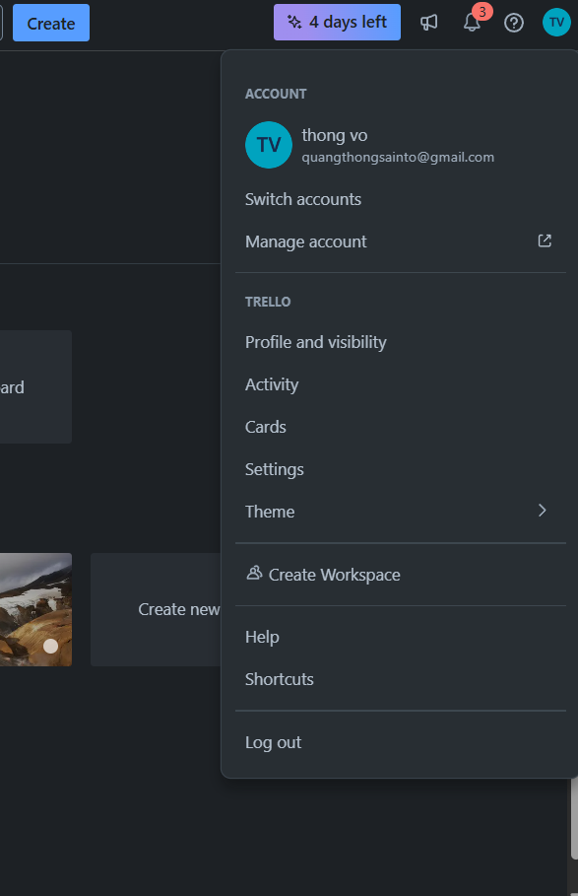
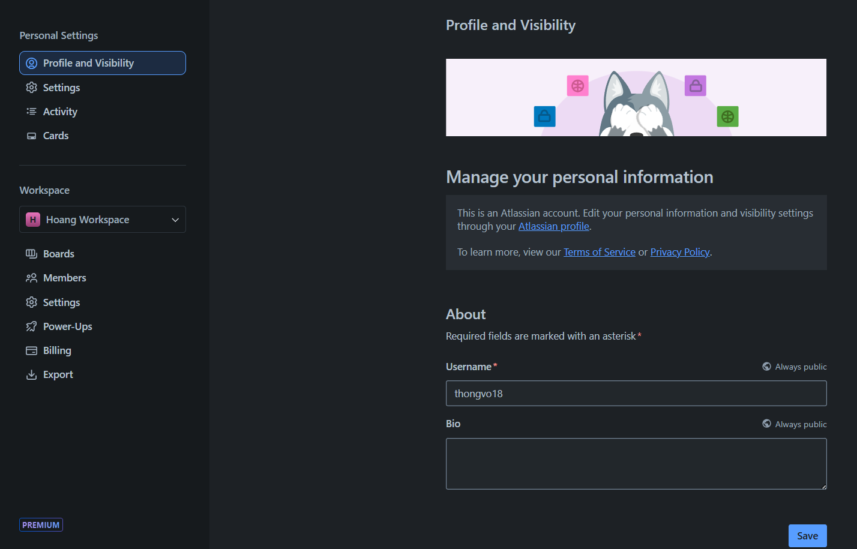
USER SCREEN
User
PictureUrl
Email
User
Click here
Username
Bio

Slide 8
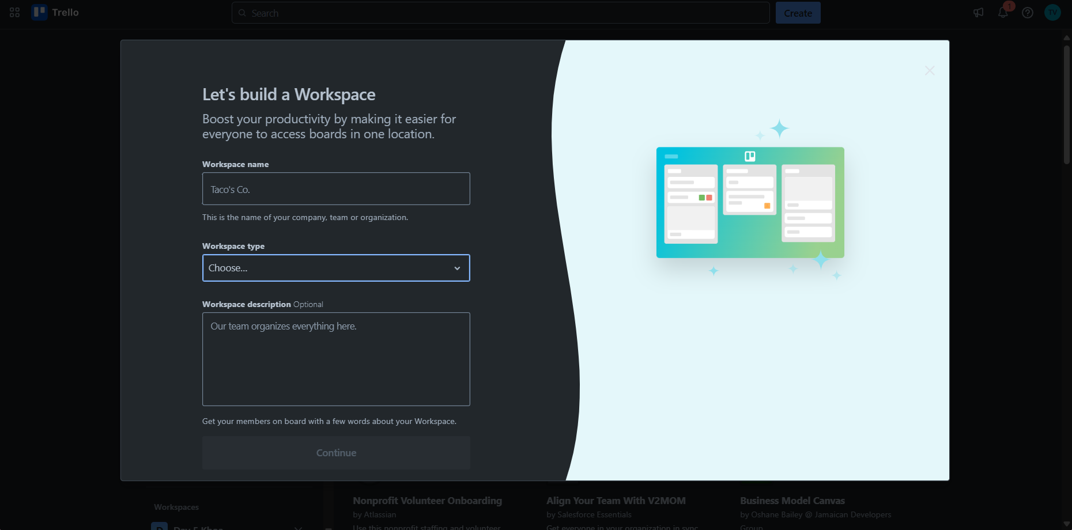
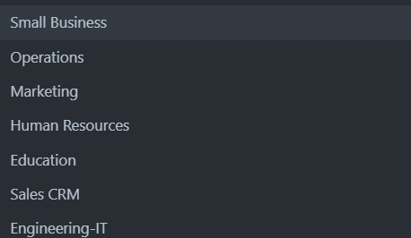
WORKSPACE CREATE SCREEN
WorkspaceType
WorkspaceName
WorkspaceType
WorkspaceTypeName
Workspace
Click here
WorkspaceDescription

Slide 9
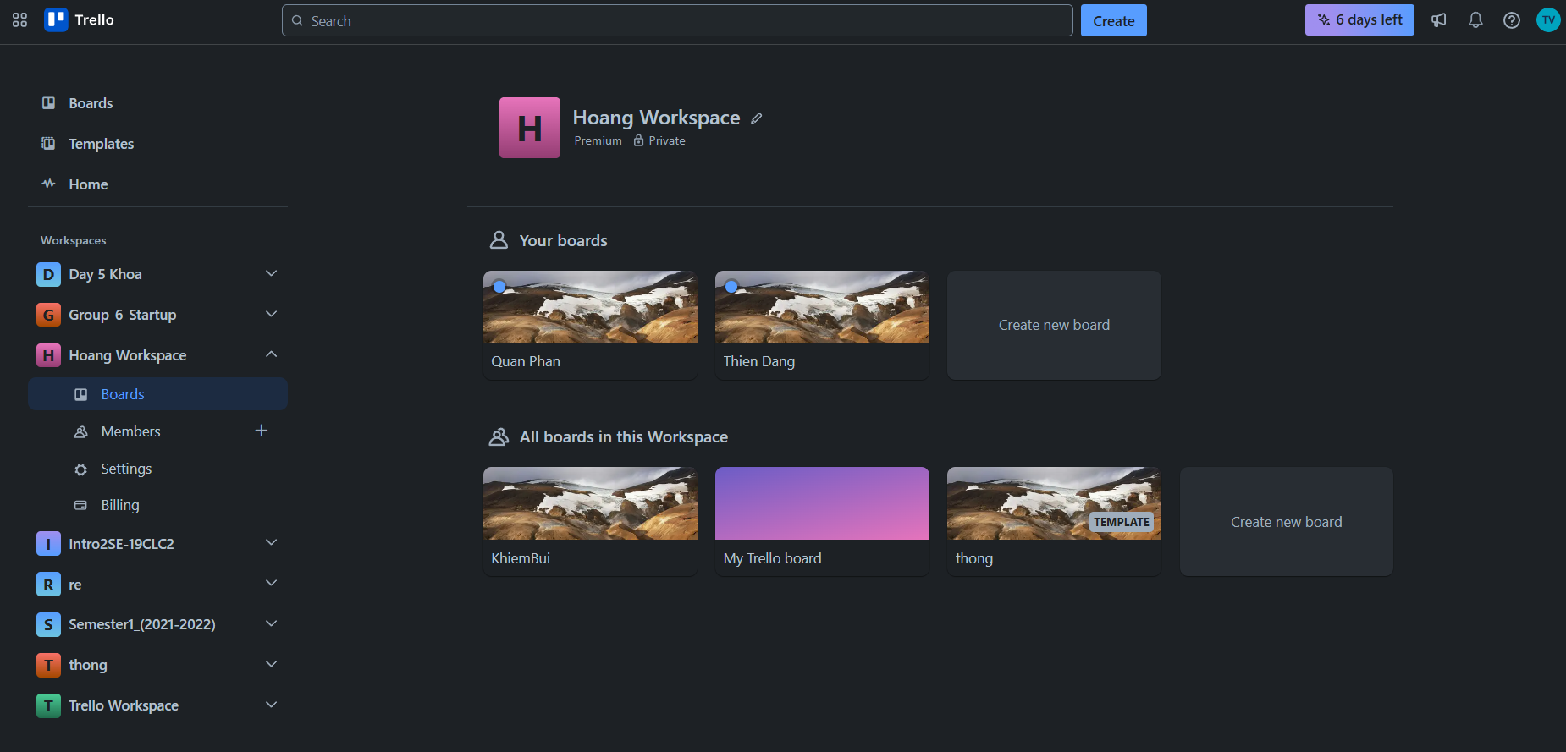

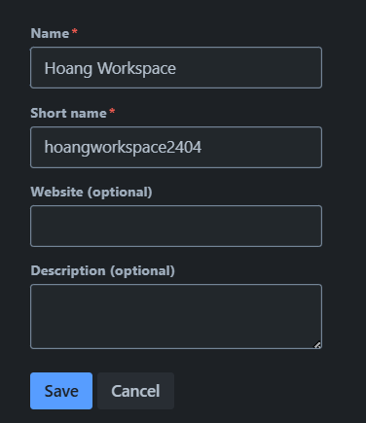
WORKSPACE SCREEN
WorkspaceName
Click here
Workspace
LogoUrl
Worksapce
SettingValue
WorkspaceName
BillingPlan
User
ShortName
Website
Board
WorkspaceDescription
Member
IsTemplate
BackgroundUrl
Board
BoardName

Slide 10
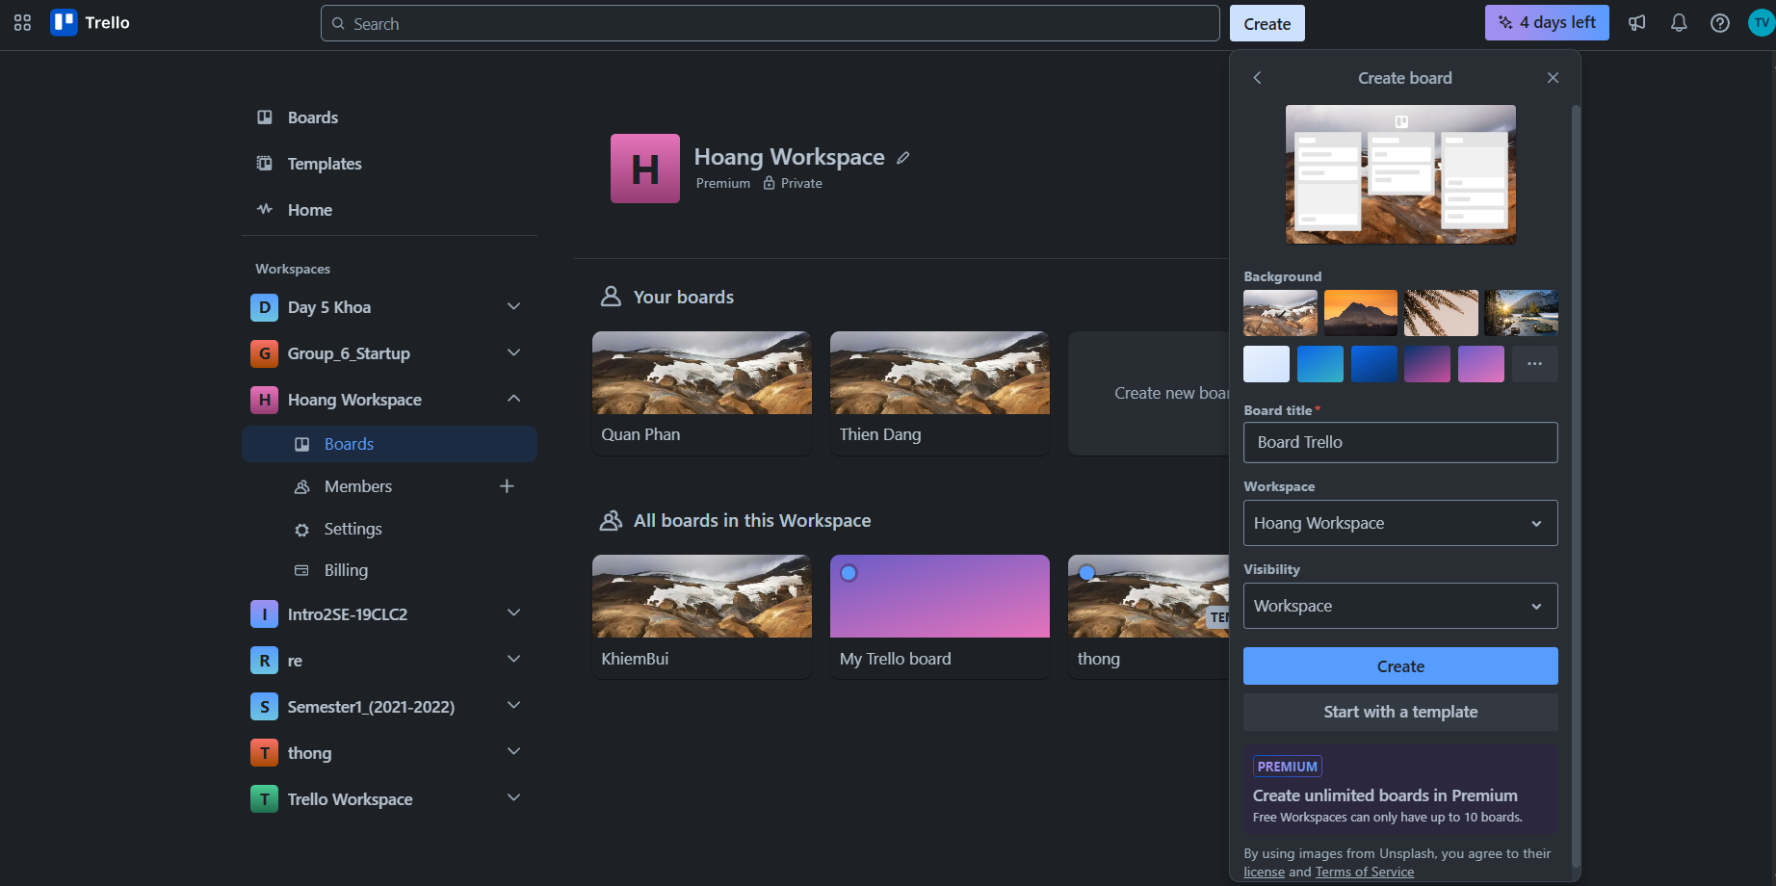
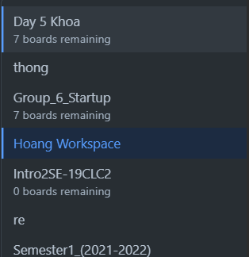
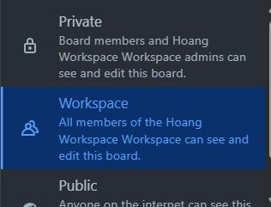
BOARD CREATE SCREEN
Click here
Board
BackgroundUrl
Workspace
WorkspaceName
BoardName
Click here
SettingKey
WorkspaceName
SettingValue
Click here
SettingOption

Slide 11
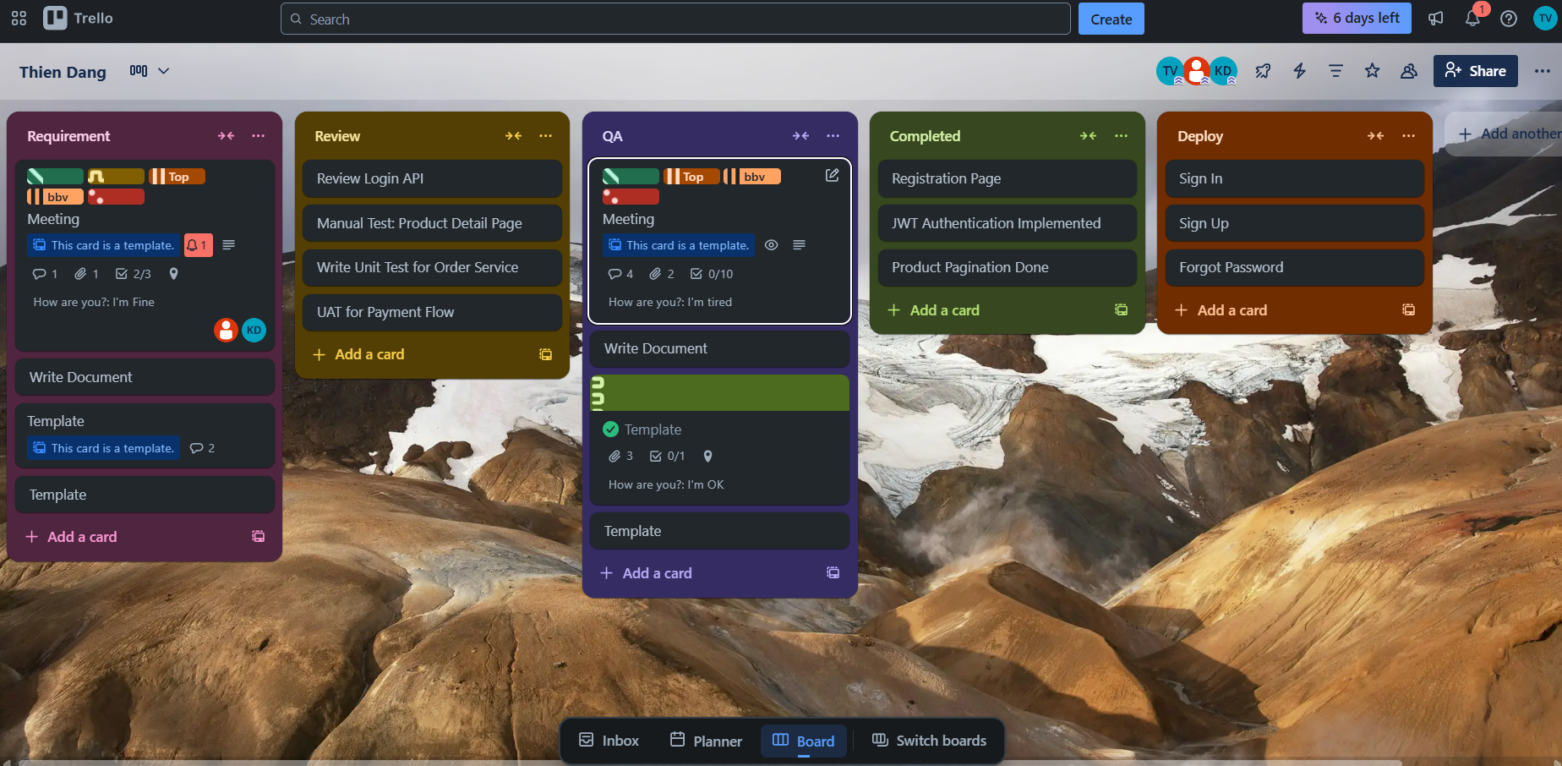
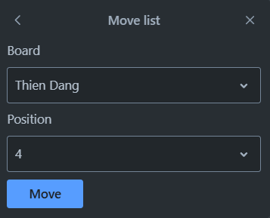
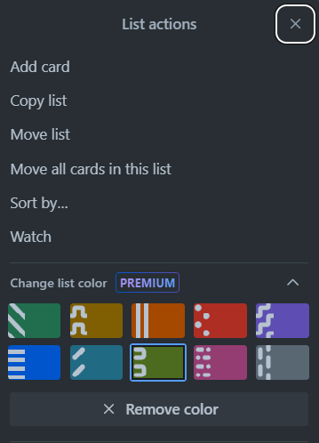

BOARD SCREEN
BoardTitle
Stage
Member
Attachment
Notification
User
StageTitle
Label
CardTitle
isTemplate
Comment
Checklist
Position
isComplete
Location
Card
CustomField
FieldValue
Icon
ColorHex
Color

Slide 12
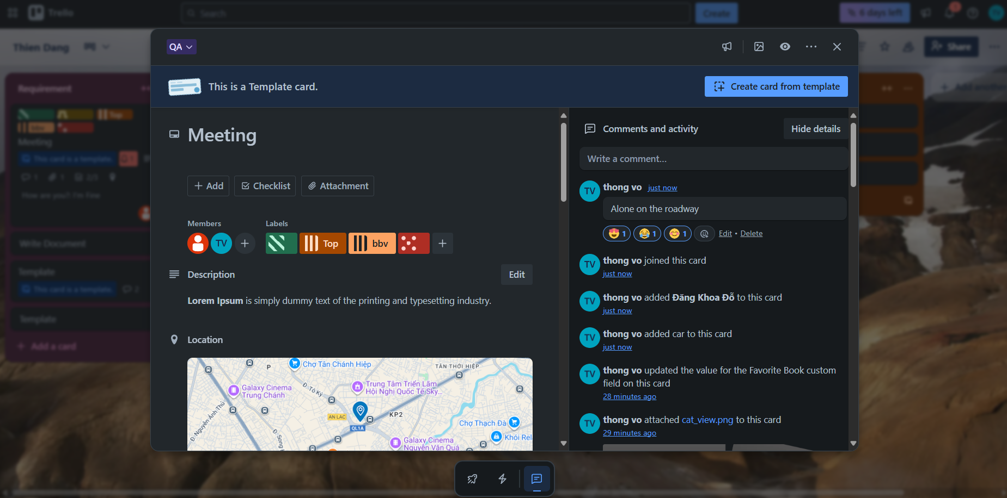
CARD SCREEN
Stage
StageTitle
Card
isTemplate
Member
CardTitle
User
Color
CreatedAt
IconColor
CardLabel
Content
Comment
NameColor
Member
Reaction
Label
CardLocation
CreatedAt
Activity
CardDescription
ActivityDescription

Slide 13
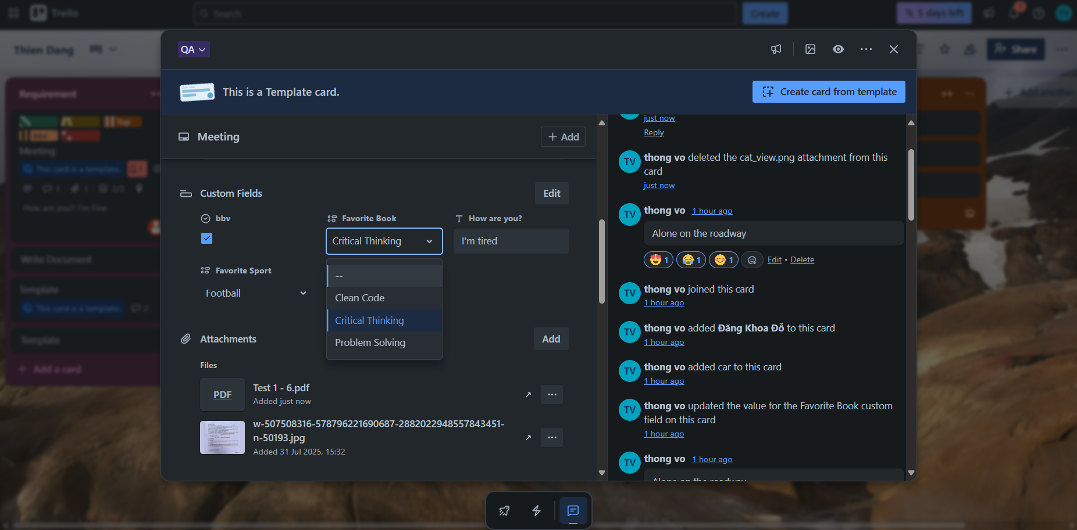
CARD SCREEN
Stage
StageTitle
User
Card
isTemplate
CardTitle
CustomFields
Activity
FieldItem
FieldValue
AttachmentName
Attachment
CreatedAt

Slide 14
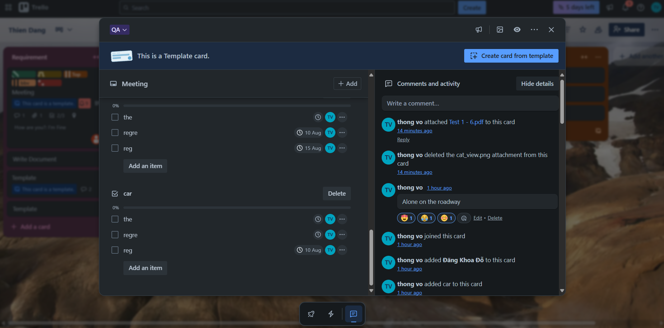
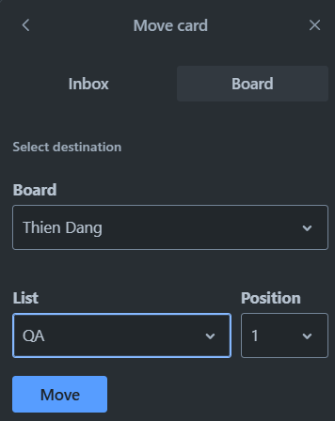
CARD IN TRELLO SYSTEM
StageTitle
isTemplate
Checklist
ChecklistItem
DueDate
CheckListItemName
CheckListItemStatus
Position
User
Member

Slide 15
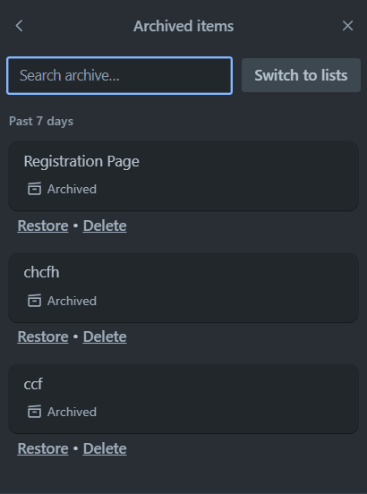
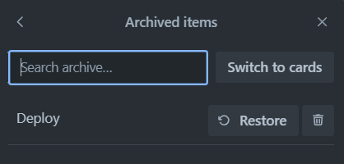
STAGE, CARD IN TRELLO SYSTEM
CardStatus

Slide 16
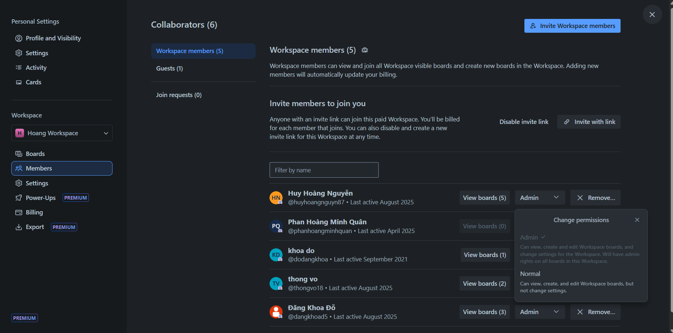
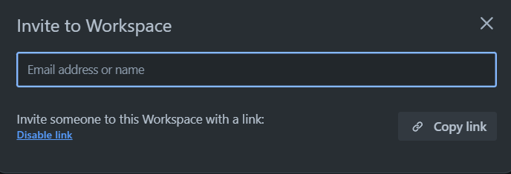
MEMBER WORKSPACE IN TRELLO SYSTEM
ShareLink
ShareLinkStatus
Workspace
OwnerType
Board
RolePermission
….
User
Member
UserAvatar
UserName

Slide 17
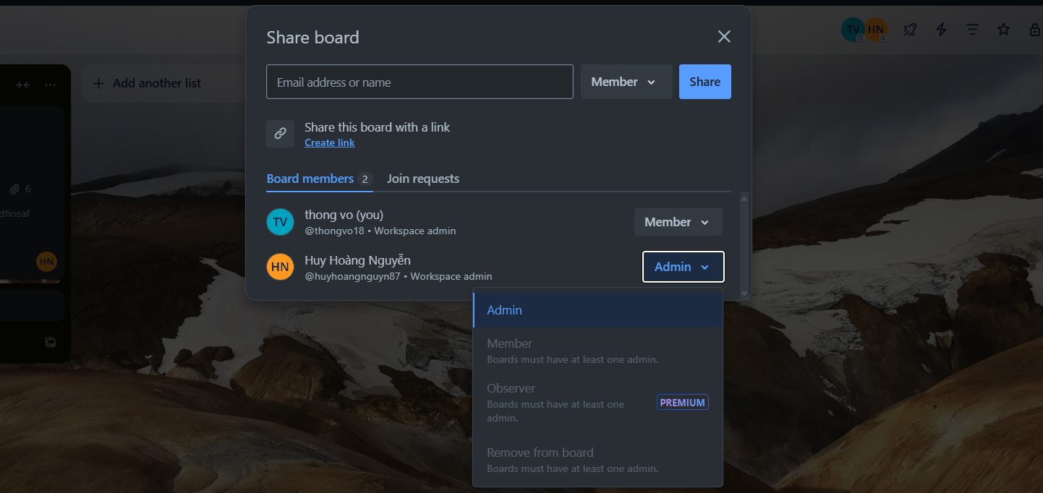
MEMBER BOARD IN TRELLO SYSTEM
OwnerType
ShareLink
User
Member
Avatar
UserName
Permission
PermissionName

Slide 18
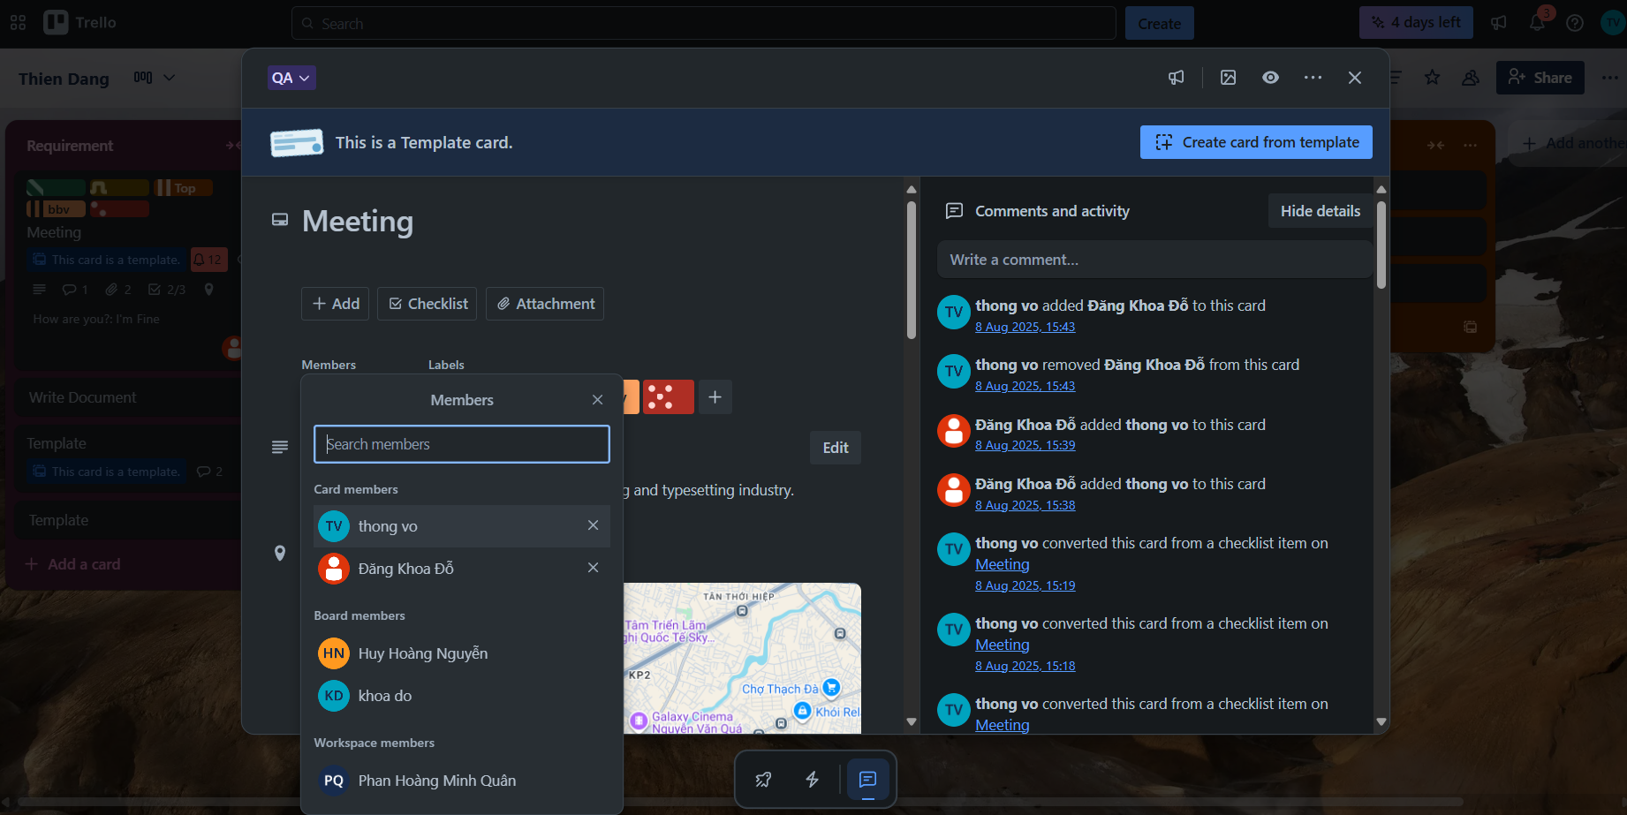
MEMBER SCREEN
OwnerType
Member

Slide 19
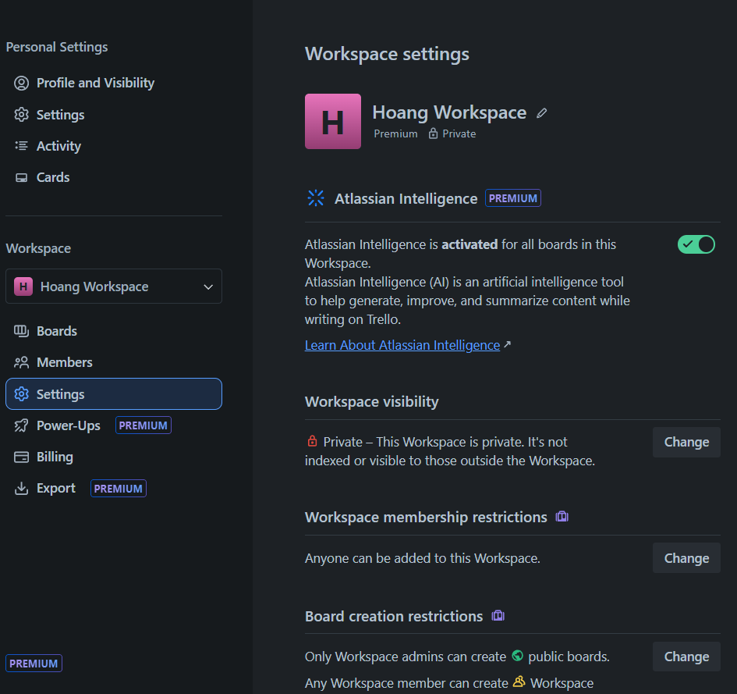
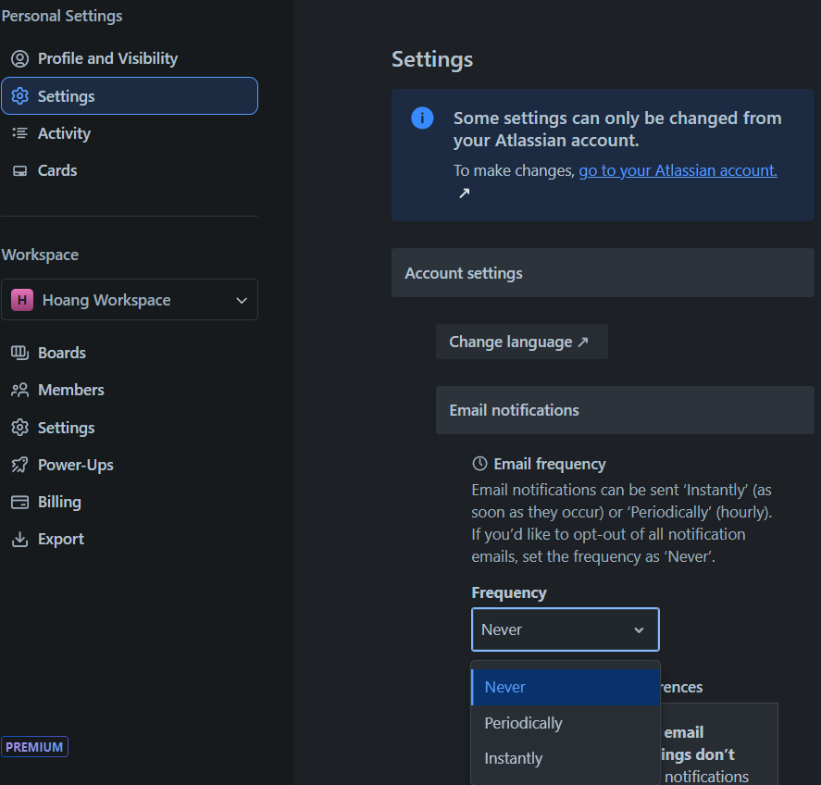
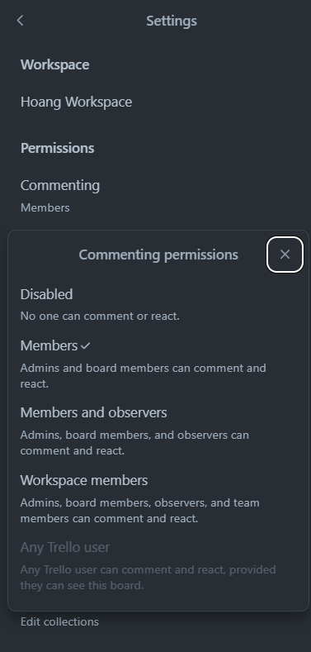
SETTINGS SCREEN
Workspace
User
Board
OwnerType
SettingKey
SettingKey
KeyName
KeyName
Description
SettingKey
DisplayValue
KeyName
SettingValue
DisplayValue
Description
SettingOption
SettingValue
DisplayValue
SettingOption
SettingKeySettingOption

Slide 20
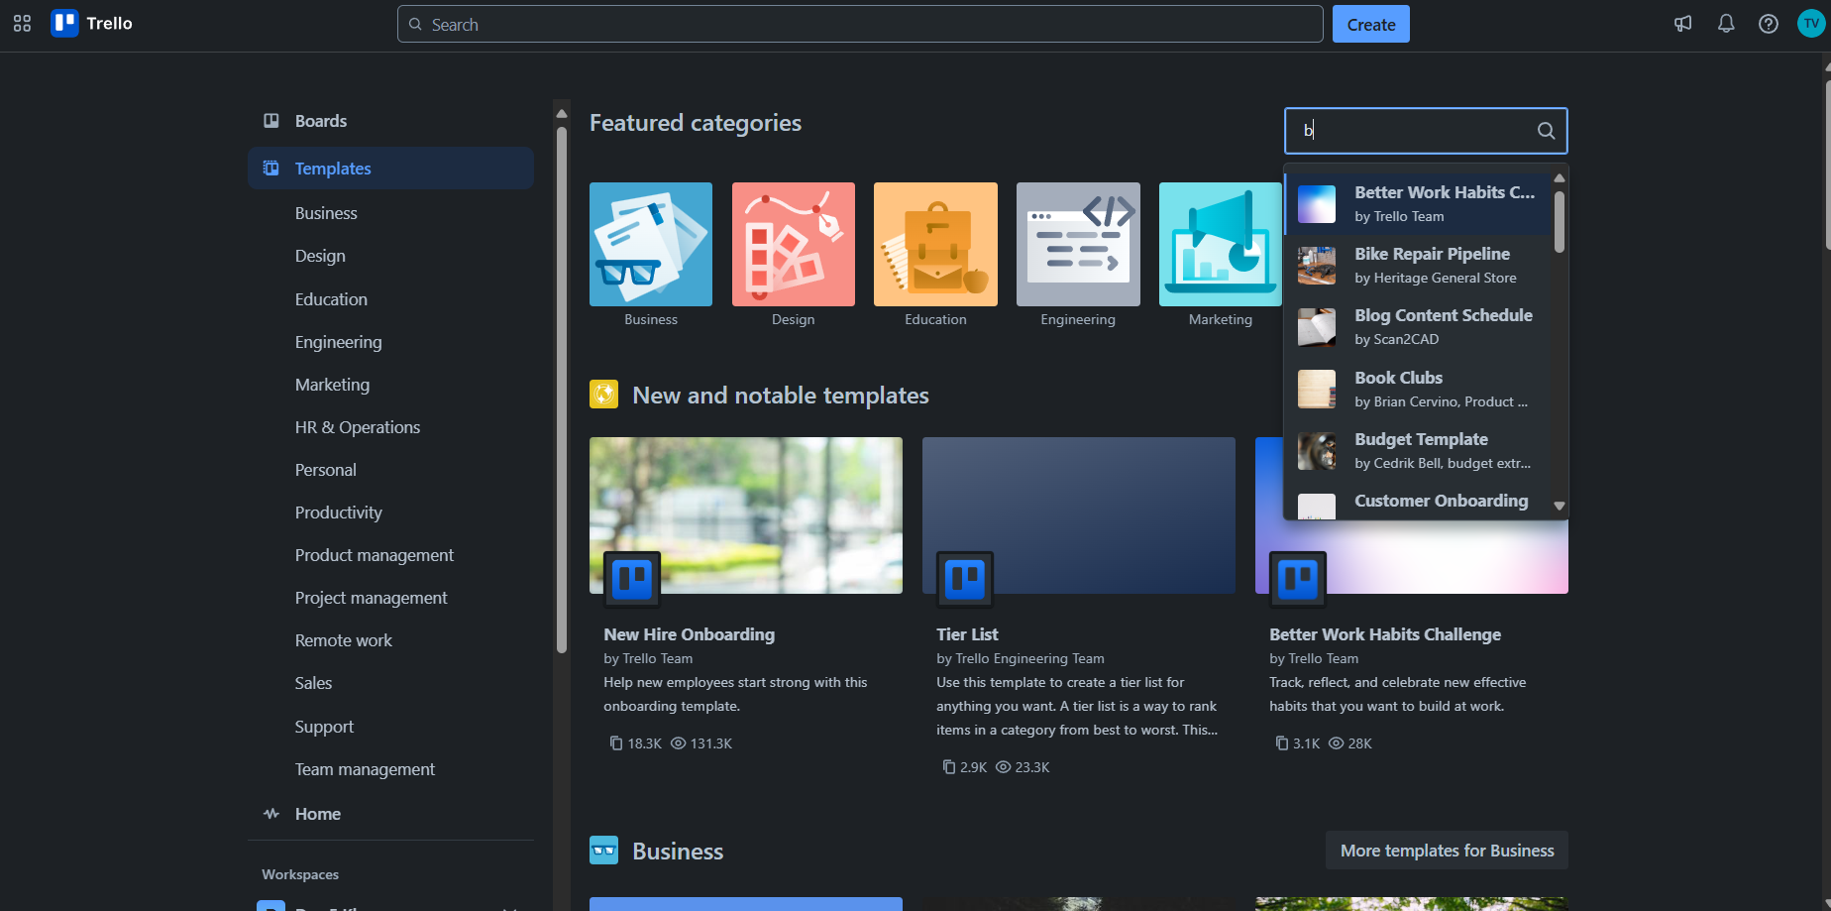
TEMPLATE SCREEN
TeamplateType
LogoUrl
Title
Board
Teamplate
PictureUrl
BackgroundUrl
User
Title
UserName
Description
TeamplateCopied
TeamplateView
Notes:
-- Get 4 recently viewed boards by user(id=1)
SELECT TOP 4 b.Id, b.BoardName, b.BackgroundUrl
FROM Boards b
JOIN BoardUsers bu ON bu.BoardId = b.Id
JOIN Users u ON u.Id = bu.UserId
WHERE bu.UserId = 1
ORDER BY bu.AccessedAt DESC;
-- Homepage: Workspace, Member
-- Get all workspace that User(id=1) is member
SELECT w.Id, w.WorkspaceName
FROM Workspaces w
JOIN Members m ON m.OwnerId = w.Id
JOIN OwnerTypes ot ON m.OwnerTypeId = ot.Id
JOIN Users u ON u.Id = m.UserId
WHERE ot.OwnerTypeValue = 'Workspace' AND u.Id = 1;
-- Get list all board that User(i=1) is member for each Workspace
SELECT b.Id AS BoardId, b.BoardName AS BoardName, w.WorkspaceName AS WorkspaceName, b.BackgroundUrl
FROM Boards b
JOIN Members m ON m.OwnerId = b.Id
JOIN OwnerTypes ot ON ot.Id = m.OwnerTypeId
JOIN Workspaces w ON b.WorkspaceId = w.Id
JOIN Users u ON m.UserId = u.Id
WHERE u.Id = 1 AND ot.OwnerTypeValue = 'Board’
-- Homepage: Board Starred
-- Get the all starred boards by the user(id=8). (Slide 4)
SELECT b.Id, b.BoardName
FROM Boards b
JOIN BoardUsers bu ON bu.BoardId = b.Id
JOIN Users u ON bu.UserId = u.Id
WHERE u.Id = 8 AND b.IsStar = 1

Slide 21
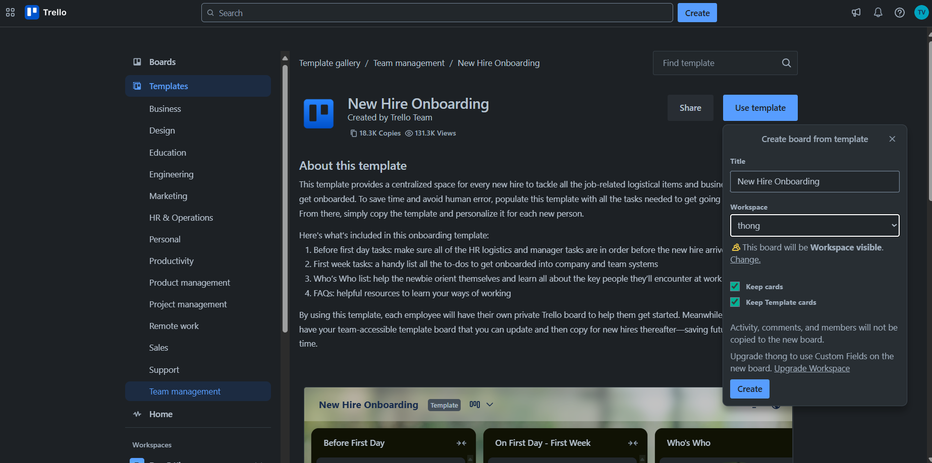
TEMPLATE SCREEN
Teamplate
Title
Name
TeamplateCopied
TeamplateView
Description
User
Description
Notes:
-- Get 4 recently viewed boards by user(id=1)
SELECT TOP 4 b.Id, b.BoardName, b.BackgroundUrl
FROM Boards b
JOIN BoardUsers bu ON bu.BoardId = b.Id
JOIN Users u ON u.Id = bu.UserId
WHERE bu.UserId = 1
ORDER BY bu.AccessedAt DESC;
-- Homepage: Workspace, Member
-- Get all workspace that User(id=1) is member
SELECT w.Id, w.WorkspaceName
FROM Workspaces w
JOIN Members m ON m.OwnerId = w.Id
JOIN OwnerTypes ot ON m.OwnerTypeId = ot.Id
JOIN Users u ON u.Id = m.UserId
WHERE ot.OwnerTypeValue = 'Workspace' AND u.Id = 1;
-- Get list all board that User(i=1) is member for each Workspace
SELECT b.Id AS BoardId, b.BoardName AS BoardName, w.WorkspaceName AS WorkspaceName, b.BackgroundUrl
FROM Boards b
JOIN Members m ON m.OwnerId = b.Id
JOIN OwnerTypes ot ON ot.Id = m.OwnerTypeId
JOIN Workspaces w ON b.WorkspaceId = w.Id
JOIN Users u ON m.UserId = u.Id
WHERE u.Id = 1 AND ot.OwnerTypeValue = 'Board’
-- Homepage: Board Starred
-- Get the all starred boards by the user(id=8). (Slide 4)
SELECT b.Id, b.BoardName
FROM Boards b
JOIN BoardUsers bu ON bu.BoardId = b.Id
JOIN Users u ON bu.UserId = u.Id
WHERE u.Id = 8 AND b.IsStar = 1

Slide 22
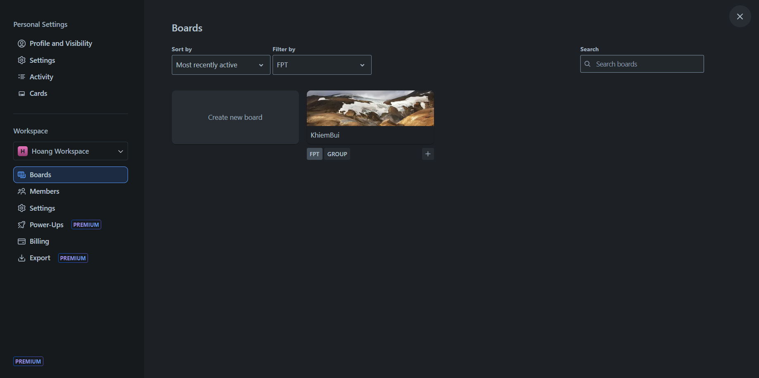
BOARD COLLECTION
Board
CollectionName
BoadName
CollectionName

Slide 23
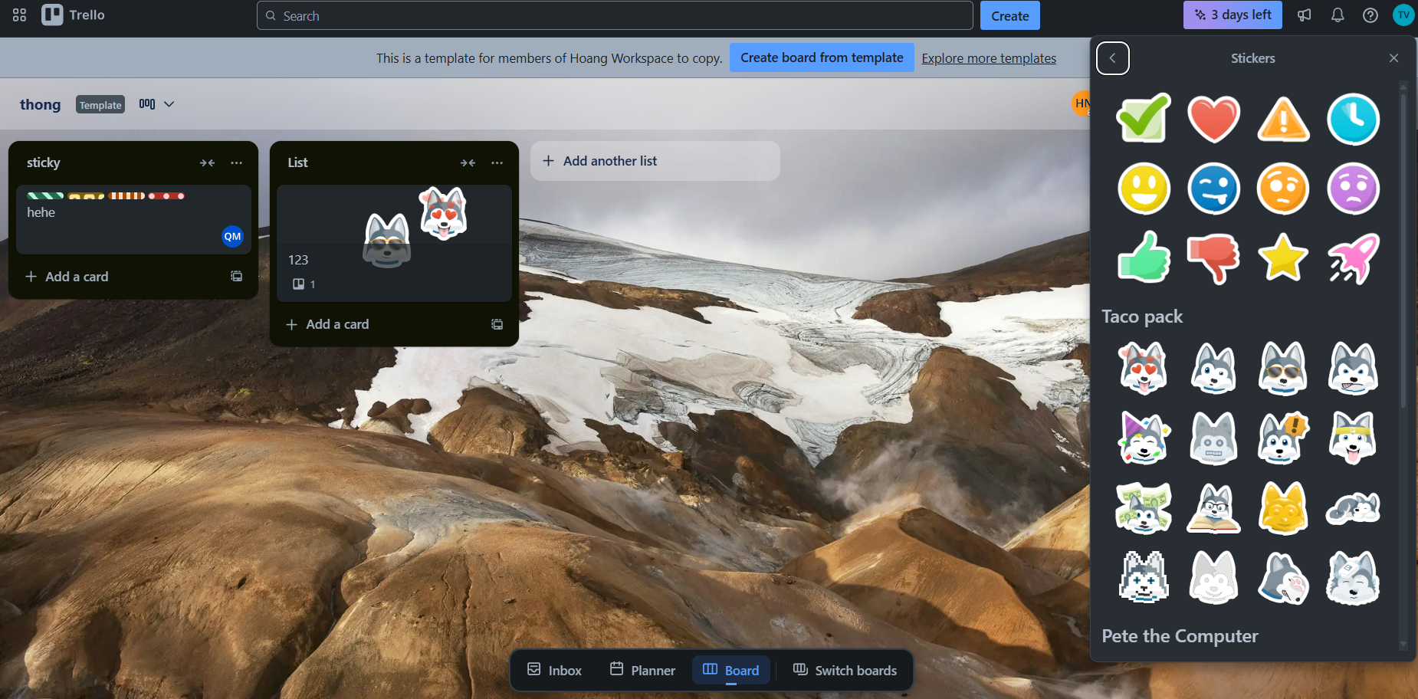
CARD STICKER SCREEN
CardSticker
StickerCategory
NameType
Icon

Slide 24
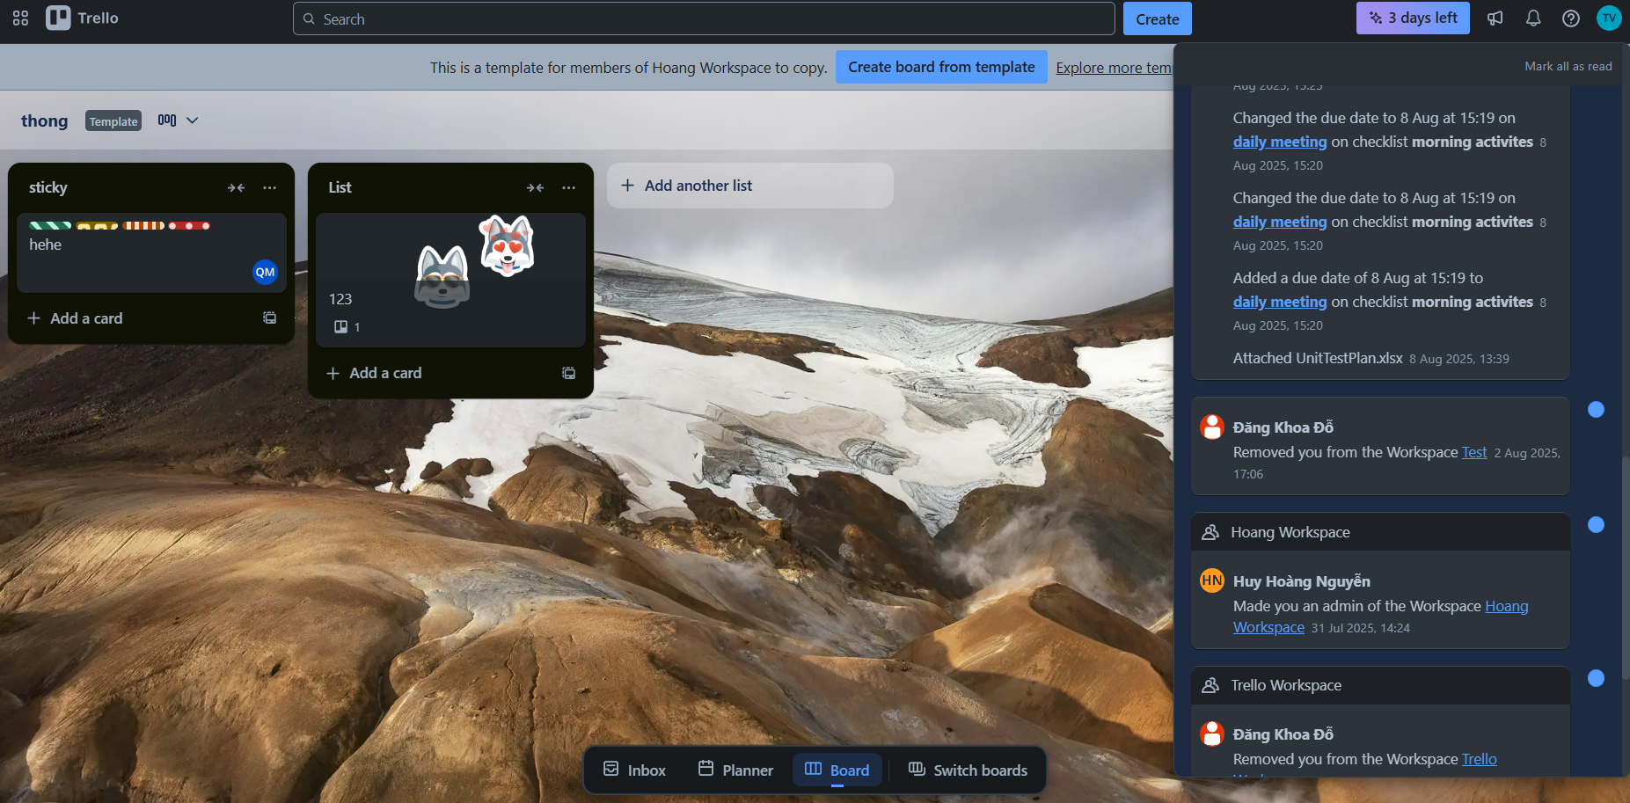
NOTIFICATION SCREEN

Slide 25

Q&A
Thank you
Intern | Trello Team

Slide 27
bbv template EN
How-to guides

Slide 28
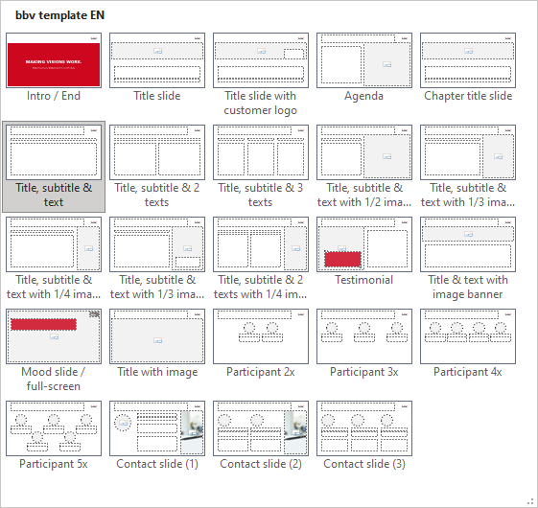
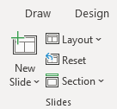
bbv Master layouts & slide library
Insert new slide
1
Click on «New Slide»
1
2
Select layout
Choose the desired layout from the pre-programmed master layouts.
2
🡪
Or select layout from slide library

Slide 29
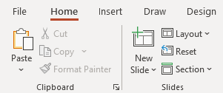
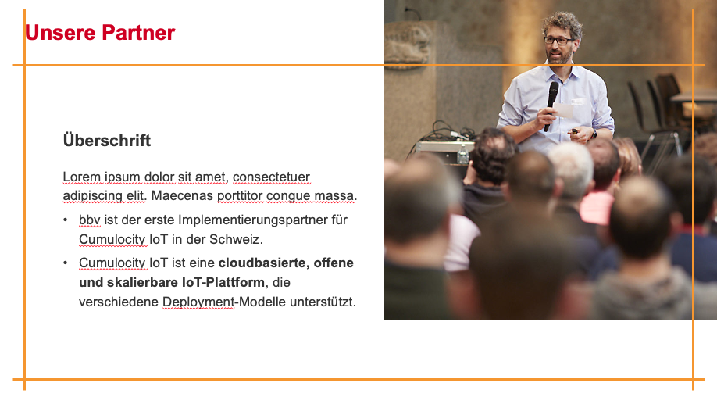
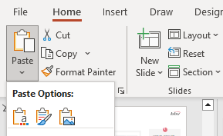

Transfer of existing slides into the new Master
1
2
3
4
Insert original slide
Copy slide in original presentation with Ctrl+C.
In the target presentation, select the slide after which the original slide is to be inserted.
Select in the tab «Home / Paste / Use Destination Theme».
Assign slide layout
Select the inserted slide
Select the desired layout in the tab «Home / Layout».
Adjust slide manually
Check all slide contents such as text blocks, images, etc. for position and size and manually adjust them to the new layout grid.
Check design
Independently check:
Font type, sizes and font colours
Colours of graphic elements
Text alignment
Coherence of the overall picture
Important:
When transferring existing slides, always carry out all four steps.

Slide 30
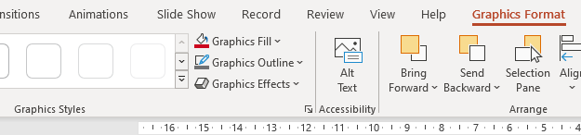

Change icon colour
Approach
Notes
Select icon
In the tab «Graphics Format» under «Graphics Styles», use «Graphics Fill» to change the colour
For some icons, the colour can be changed by using «Graphics Outline» instead of «Graphics Fill».
The colour cannot be changed if an icon is inserted as a picture. In this case, after selecting the icon, the tab «Picture Format» appears instead of «Graphics Format».
Best vector file format for icons: *.svg

Slide 31



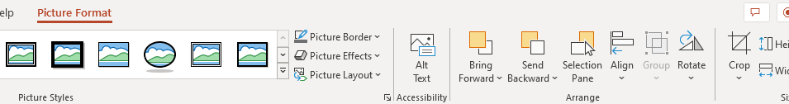


Insert image into placeholder
Insert image from external source
Click on the image icon, select image from Sharepoint or other source
The bbv image library is here locally located: C:\Users\Public\bbv_templates\Marketing\PPT-Bibliotheken\Bilder-Bibliothek
Or: copy image from external source with Ctrl+C, select the placeholder, then paste with Ctrl+V
Adjust
Select the image
Click in the tab «Picture Format» on «Crop»
Adjust the image composition by moving the image
Resize the image by clicking and dragging the outer circles.
Click again on «Crop» to finish the adjustments

Slide 32


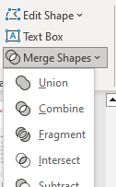

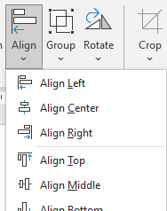

Insert image into mock-up screen (mobile/laptop)
Mock-up
Paste image
Copy image from external source with Ctrl+C and paste with Ctrl+V
Image mask
Adjust size & determine image area:
Place image behind image mask
Adjust image size and determine image area
Image mask
Crop image to image mask
Select image
Select image mask
Click in the tab «Shape Format / Merge Shapes» on «Intersect»
Combine image with mock-up
Place image behind mock-up
Activate image and mock-up and align both horizontally (Align Center) and vertically (Align Middle)
Group image and mock-up with Ctrl+G

Slide 33
bbv template EN
Style guide

Slide 34
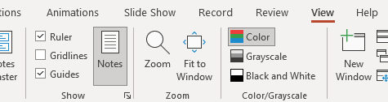

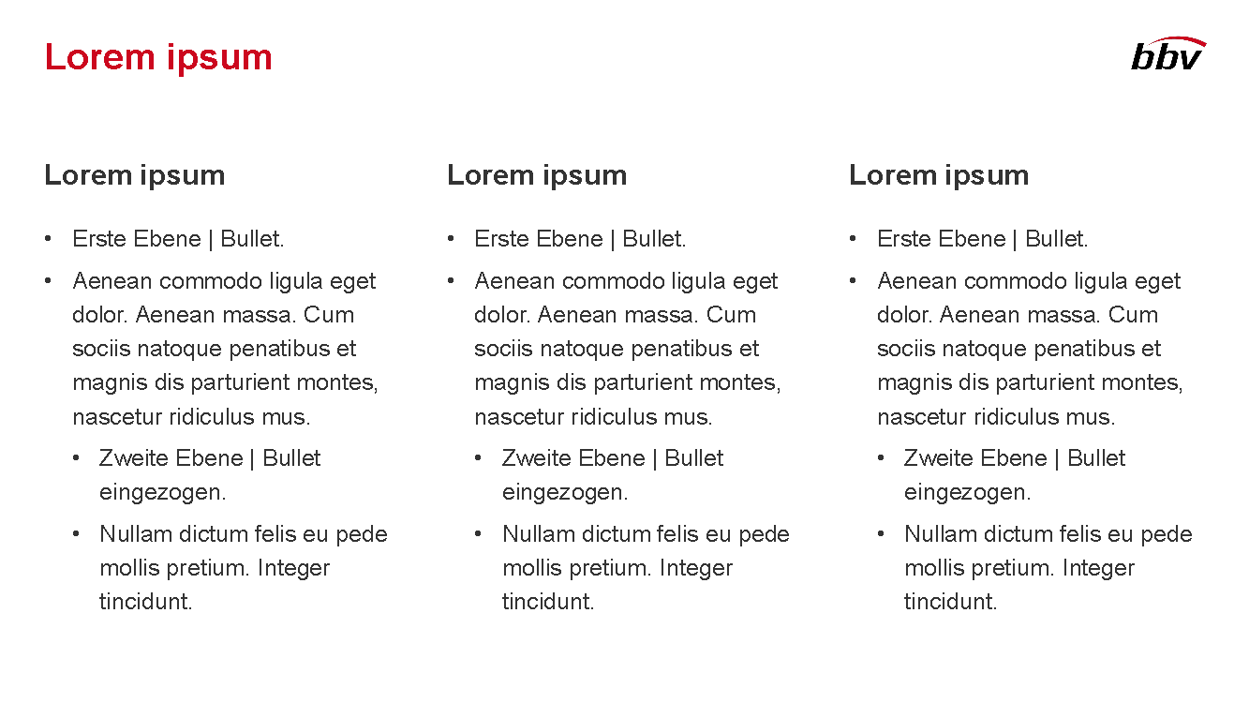
Working area, guides & ruler
Working area
Depending on the slide, a single-column layout, a 2-column or 3-column layout is used.
Display the ruler and guides in the «View» tab.

Slide 35
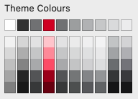
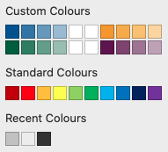
bbv colour theme
Always OK!
Never, please!
Default text colours
Main accent
Colours for diagrams, charts, graphs etc.
Use selectively and sparingly
Never, please!
Colours for diagrams, charts, graphs etc.
Colours for diagrams, charts, graphs etc.

